Slide 1



The Caribbean Energy Frontier:
Navigating Next
Cheryl Lewis
Office of Utilities Regulation, Jamaica
Text 22 September 2026

Slide 2
The Caribbean Energy Frontier: Navigating Next
Table of Contents
Introduction
Accelerating Renewables Adaptation
Regional Pooled Procurement
Establishing New Regulatory Frameworks
Climate Resilience and Infrastructure Development
Collaboration

Slide 3
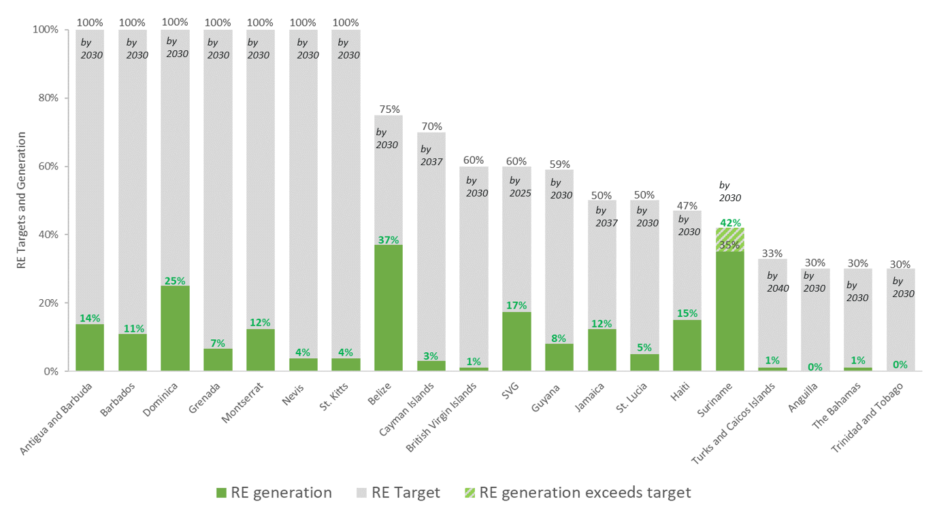
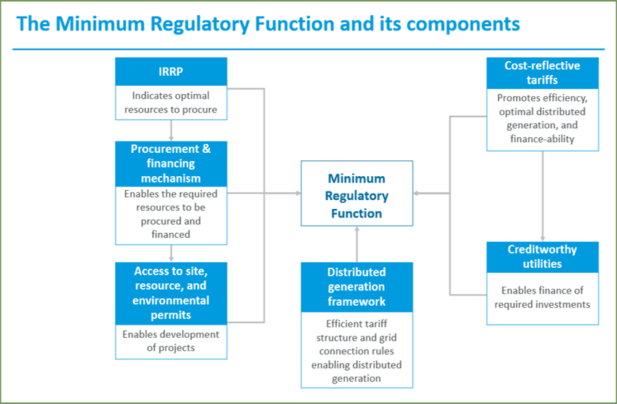

The Caribbean Energy Frontier: Navigating Next
Accelerating Renewables Adaptation

Slide 4
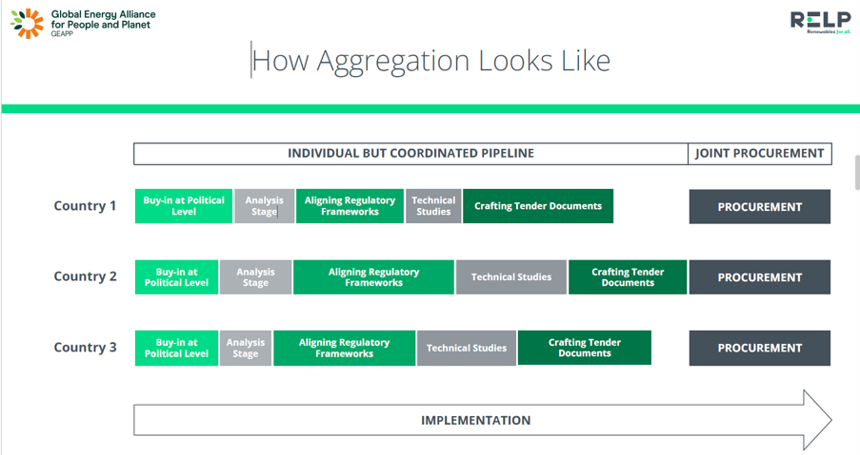

The Caribbean Energy Frontier: Navigating Next
Regional Pooled Procurement

Slide 5
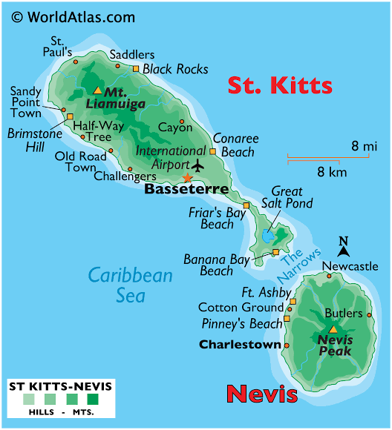

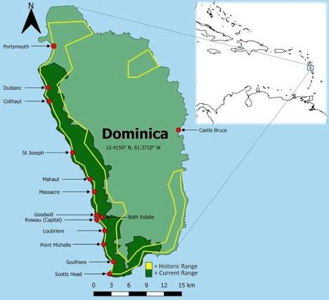
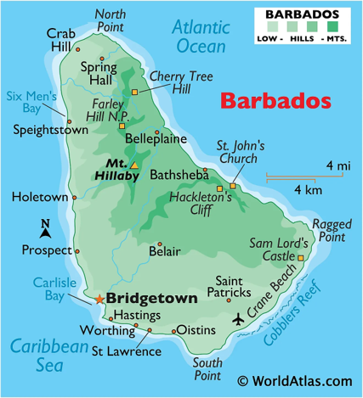
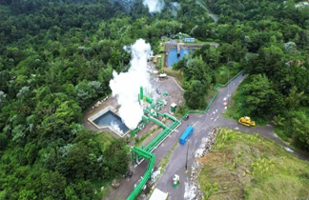

The Caribbean Energy Frontier: Navigating Next
Establishing New Regulatory Frameworks

Slide 6

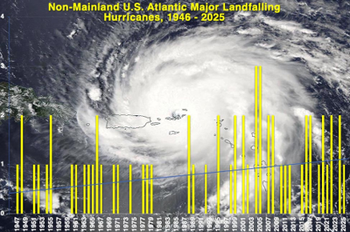
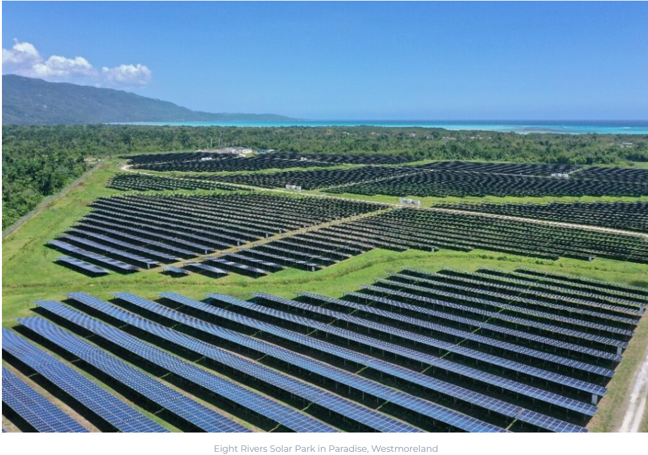
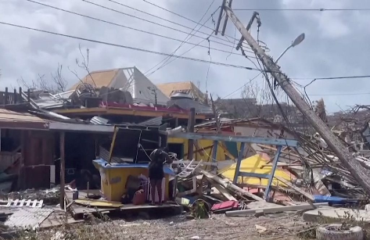
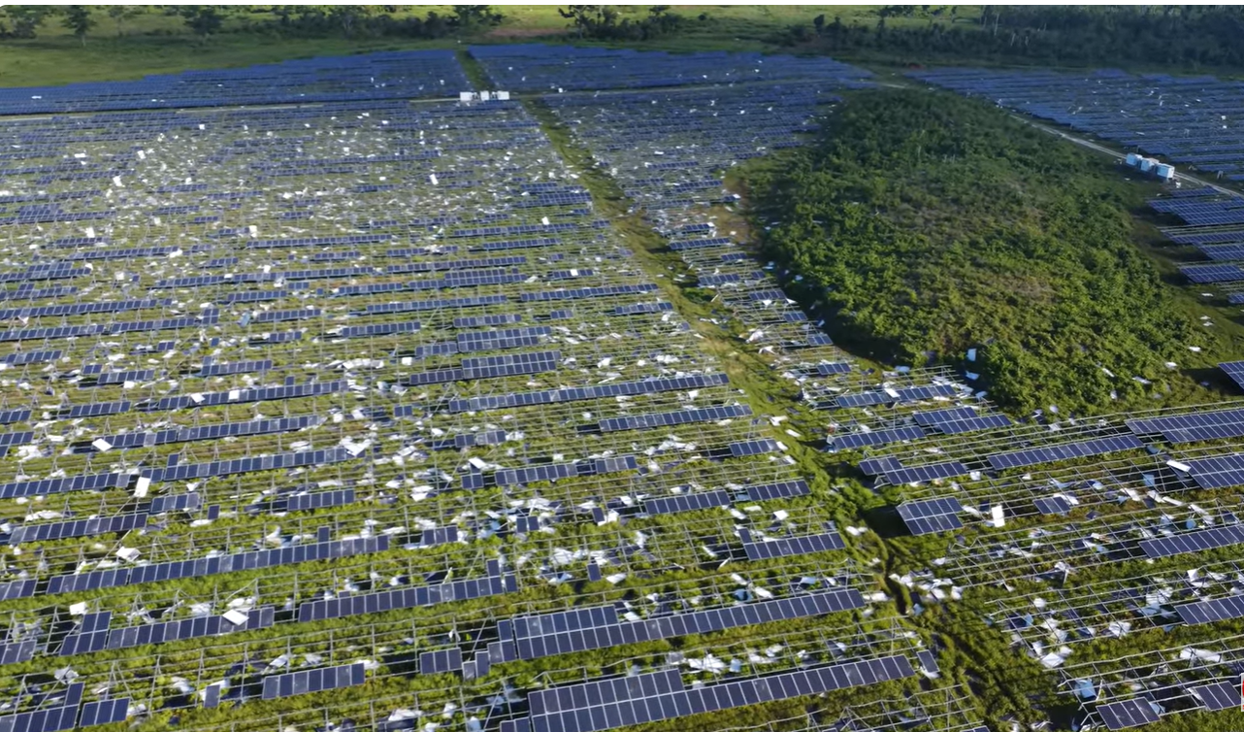
The Caribbean Energy Frontier: Navigating Next
Jamaica and St Vincent & the Grenadines
2017 – Hurricanes Harvey (Cat 4), Irma (Cat 5) and Maria (Cat 4):
US Virgin Islands
British Virgin Islands
Turks & Caicos, Puerto Rico, St. Eustatius, Barbuda
2024 – Hurricane Beryl (CAT 5, 165 mph):
Jamaica, Windward Islands
2025 – Hurricane Melissa (Cat 5, :190 mph) – strongest hurricane in the Atlantic Basin

Slide 7

Cheryl Lewis
Office of Utilities Regulation, Jamaica

